Slide 1
CS1010X Lecture Note 15:
Object Oriented Programming with Java
Notes:
Lecture 15a Video

Slide 2
Difficulties?
CS = Algorithm + Data Structure
Last lecture is very much on writing algorithm
  Static method – no need to say the object
  Instance method – need to have the object (this lecture)
This lecture is on designing “data structure” / ADT
  Object is to encapsulate ALL the information (data), plus possible algorithms working on each object
    Data can be primitive data, compound data/structure
    (like tuple of tuples in Python)
    Computation is done through object interacting with object

Slide 3
Lecture Overview
Intro to Object Oriented Programming
OOP Features in Java
  2.1 Encapsulation
  2.2 Inheritance
  2.3 Polymorphism
Complex number (repeat Lecture 10 in Java)

Slide 4
Object Oriented Programming
Definition and Motivation
(may overlaps with some earlier lectures)

Slide 5
1. OO Language – main features
  Encapsulation
    Group data & associated functionalities into a single package
    Hide internal details from outsider
  Inheritance
    A meaningful way of extending current implementation
    Introduce logical relationship between packages
  Polymorphism
    Behavior of the functionality changes according to the actual type of data

Slide 6
1. OO Implementation
Function
Use process to manipulate data
Data
Encapsulation of data and function
No direct access to data

Slide 7
1. OO language: Characteristics
  View program as a collection of objects
    Computation is performed through interaction of objects
  Each object has a set of capabilities (functionalities) and information (data)
    Capabilities are exposed selectively to the public
    Data are generally kept within the object

Slide 8
2. OO Language
Advantages:
  Easier to design as it closely resemble the real world
  Easier to maintain:
    Modularity is enforced
    Extensible
Disadvantages:
  Less efficient in execution
    Further removed from low level execution
  Program is usually longer with high design overhead

Slide 9
Java: Object Oriented Features
What makes Java Object Oriented
* Python BankAcct class is provided in the teaching resource for comparison with that of Java BankAcct class

Slide 10
Java : OO language
Enforce OOP principles
Methods:
  Static method
  Instance method
Method Parameters:
  passed by value (no change to value)
  passed by object (change to value)

Slide 11
2.1 Encapsulation
Managing complexity

Slide 12
2.1 Encapsulation through Classes
A logical grouping of “data + processes == class”
  A class is a user defined data type
  Variables of a class are called objects (instances)
A class contains:
  Data: each object has an independent copy
  Functions: process to manipulate data in an object
Terminology:
  Data of a class :
    member data (attributes)
  Functions of a class:
    member functions (methods)

Slide 13
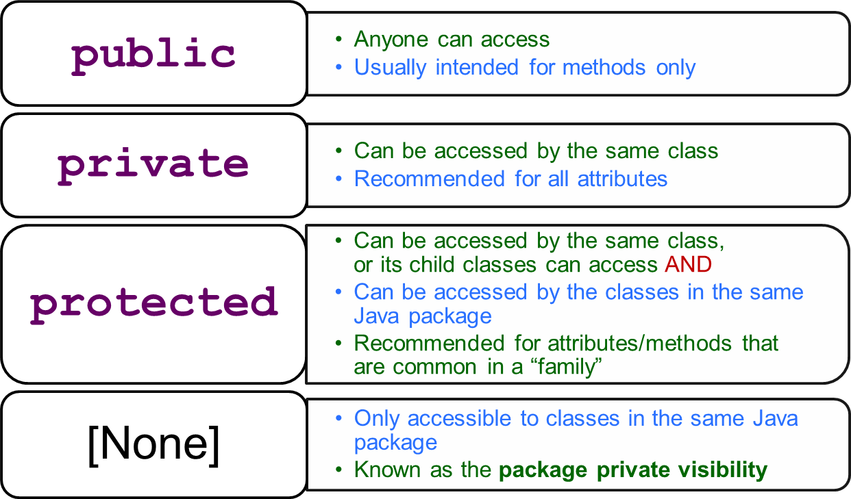
2.1 Accessibility
Attributes and methods can have different level of accessibilities (visibilities)

Slide 14
2.1 Bank Account : Java Implementation
class BankAcct {
private int _acctNum;
private double _balance;
public boolean withdraw( double amount ) {
if ( _balance < amount )
return false;
_balance -= amount;
return true;
}
public void deposit( double amount ) {
if ( amount <= 0 )
return;
_balance += amount;
}
}
Good coding habits:
Separate attributes and methods
Use "_" or myXXXX to denote attributes
BankAcct.java

Slide 15
2.1 Bank Account : Java Implementation
class BankAcct {
private int _acctNum;
private double _balance;
public boolean withdraw( double amount ) {
...
}
public void deposit( double amount ) {
...
}
public void print( ) {
System.out.println( "Account Number: " + _acctNum );
System.out.printf( "Balance: $%.2f\n", _balance );
}
}
BankAcct.java

Slide 16
2.1 Constructors
Each class has one or more specialized methods known as constructor
  Called when an object is created
  Useful for initializing the attributes of an object
Default constructor
  Take in no parameter
  Automatically provided by the compiler if programmer does not define any constructor method
    Initialize all attributes to 0
Non-default constructor
  Can take in parameter
  Can have multiple different constructors

Slide 17
2.1 Constructors: Example
class BankAcct {
private int _acctNum;
private double _balance;
public BankAcct( ) {
//initialize all attributes to 0
}
public BankAcct( int aNum, double bal ) {
//initialize attributes with user provided values
_acctNum = aNum;
_balance = bal;
}
//Other methods not shown
}
Syntax Note:
- Constructor has NO return type.
- Constructor has the same name as the class
BankAcct.java

Slide 18
2.1 Class and Object
The class declaration defines a new data type
  No actual variables are allocated!
To have an instance of a class:
  Create (instantiate) object
  Variable that refers to an object is known as reference in Java
The distinction between class and object
  Analogy: class == blue print, object == actual house
  Human is a class, each of us is an object of this human class
To access public attribute or method of an object
  Use the “.” dot operator

Slide 19
2.1 Bank Account : Example usage
class BankAcct { …… } //not shown
class TestBankAcct {
public static void main( String[] args ) {
BankAcct ba1 = new BankAcct( );
BankAcct ba2 = new BankAcct( 1234, 99.99 );
ba1.deposit( 1000 );
ba2.withdraw( 500.25 );
//Accessibility restricts access, the following
// statements will result in compilation error
ba1._acctNum = 555555;
ba1._balance += 12345.99;
}
}
Syntax Note:
"new" keyword creates an object
One of the constructors is used
TestBankAcct.java

Slide 20
2.1 Object Reference Data Type
All non-primitive data type variable is an object reference
ba1
class BankAcct { …… } //not shown
class TestBankAcct {
public static void main( String[] args ) {
BankAcct ba1 = new BankAcct( );
BankAcct ba2;
ba2 = ba1;
ba1.deposit( 1000 );
ba2.print();
}
}
ba2
…
…
_acctNum
0
_balance
0.00
1000.00
1000.00
…
…
What is the output?

Slide 21
2.1 What is “this” reference?
A common confusion:
  How does the method “knows” which is the “object” currently executing?
When a method is called by: object.method(…)
  a reference to the calling object is set automatically
  With the name “this”, meaning “this particular object”
All attributes/methods are then accessed implicitly through this pointer/reference

Slide 22
2.1 Object : What is “this”
class BankAcct {
//... other code not shown ...
public boolean withdraw( double amount )
{
if (_balance < amount)
return false;
_balance -= amount;
return true;
}
}
this
ba1
ba2
…
…
_acctNum
1234
_balance
300.50
300.50
200.50
_acctNum
9999
//Code fragment only
BankAcct ba1 = new BankAcct( 1234, 300.50 );
BankAcct ba2 = new BankAcct( 9999, 1001.40 );
ba1.withdraw(100.00);
ba2.withdraw(100.00);
…
…
_balance
1001.40
Inside this withdraw() method

Slide 23
2.1 Object : What is “this”
class BankAcct {
//... other code not shown ...
public boolean withdraw( double amount )
{
if (_balance < amount)
return false;
_balance -= amount;
return true;
}
}
this
ba1
ba2
…
…
_acctNum
1234
_balance
300.50
200.50
_acctNum
9999
//Code fragment only
BankAcct ba1 = new BankAcct( 1234, 300.50 );
BankAcct ba2 = new BankAcct( 9999, 1001.40 );
ba1.withdraw(100.00);
ba2.withdraw(100.00);
…
…
_balance
1001.40
901.40
Inside this withdraw() method

Slide 24
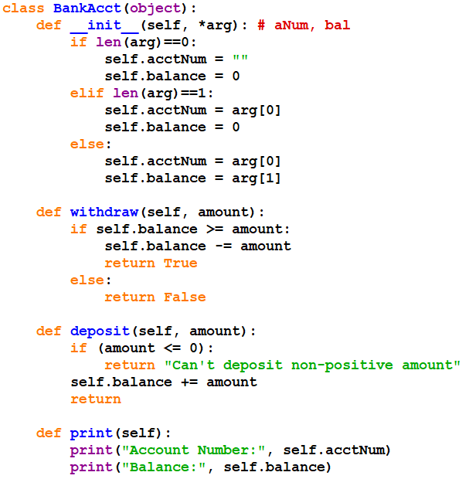
Python: BankAcct class

Slide 25
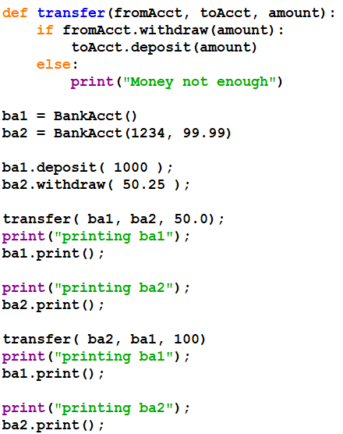
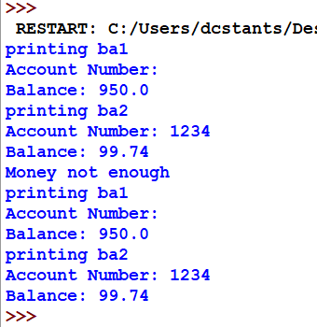
Python: Testing BankAcct class
Output from IDLE:

Slide 26
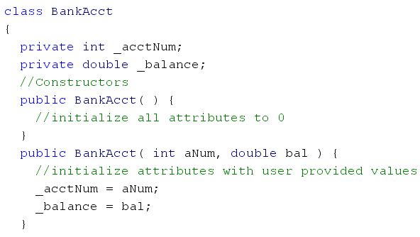
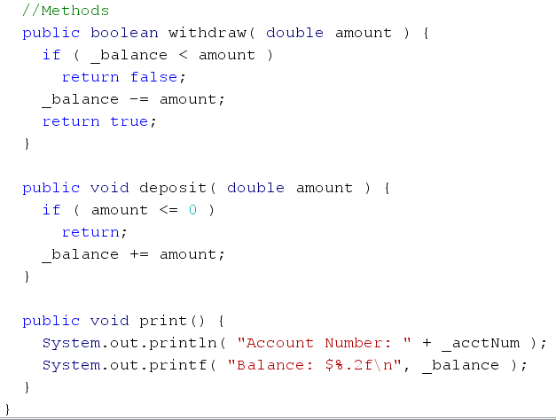
Java: BankAcct class

Slide 27
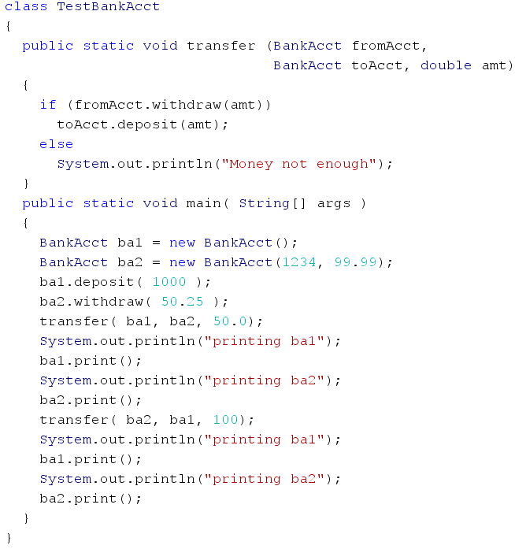
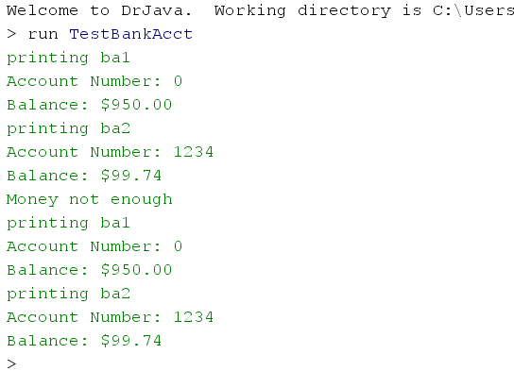
Java: TestBankAcct class
Output:

Slide 28
2.1 Instance Method vs Static Method
Methods in the BankAcct class are known as instance methods:
  You need an object reference of the right type to invoke these methods
  These methods have access to the attributes in the object automatically
Different from static method covered (last lecture)
  Static methods have no access to object attributes
    i.e. there is no additional data other than the parameters
  Distinguished by the modifier "static" in front of the method return type

Slide 29
2.2 Inheritance
Like father, like son
Avoid writing same codes
Notes:
Lecture 15b Video

Slide 30
2.2 Inheritance : Motivation
Let’s define a saving account class
Basic Information:
  account number, balance
  interest rate
Basic Functionality:
  withdraw, deposit, print
  pay_interest
Compared with a basic account:
  Differences are highlighted in bold font
  Saving Account shares > 50% code with Bank Account
    Should we just cut and paste the code?
      No, to avoid maintenance issues of correcting or modifying many copies

Slide 31
2.2 Inheritance : Motivation
Object oriented languages allow inheritance
  Declare a new class based on an existing class
  The new class inherits all of the attributes and methods from the other class
  The new class augments/modifies the inheritance to suit objectives of the new class
Terminology:
  If class B is derived from class A, then
    class B is called a child (sub-class) of class A
    class A is called a parent (super-class) of class B

Slide 32
2.2 Saving Account : Implementation
class BankAcct {
protected int _acctNum;
protected double _balance;
//Constructors and methods not shown
}
The "protected" keyword allows subclass to access the attributes directly
(amended BankAcct.java)
class SavingAcct extends BankAcct {
protected double _rate; //interest rate
public void payInterest( ) {
_balance += _balance * _rate;
}
}
The "extends" keyword indicates inheritance
SavingAcct.java

Slide 33
2.2 Observations
Inheritance reduces redundant coding
  No definition of account number & balance
  No definition of withdraw() and deposit()
Improve maintainability:
  E.g. If the withdraw() method is modified in class BankAcct
    no changes is needed in class SavingAcct
  The code in class BankAcct remains untouched
    Other programs using BankAcct are not affected

Slide 34
2.2 Constructors in subclass
Note that constructors are not inherited
  Should define constructor(s) for the subclass
class SavingAcct extends BankAcct {
protected double _rate; //interest rate
public SavingAcct(int aNum, double bal, double rate) {
_acctNum = aNum;
_balance = bal;
_rate = rate;
}
//......payInterest() method not shown
}
SavingAcct.java

Slide 35
2.2 The "super" keyword
The "super" keyword allows us to use the methods in the superclass directly
    Including constructors
If you make use of superclass's constructor, make sure it is the first statement in method body
class SavingAcct extends BankAcct {
protected double _rate; //interest rate
public SavingAcct(int aNum, double bal, double rate) {
super( aNum, bal );
_rate = rate;
}
}
Use the constructor in BankAcct class
SavingAcct.java

Slide 36
2.2 Saving Accounts : Sample Usage
class BankAcct { …… } //not shown
class SavingAcct { …… } //not shown
class TestInheritance {
public static void transfer( BankAcct fromAcct,
BankAcct toAcct, double amt) { …… }
public static void main( String[] args ) {
SavingAcct sa1 = new SavingAcct( 2, 1000.0, 0.03 );
sa1.withdraw( 50.0 );
sa1.payInterest();
sa1.print();
}
}
Inherited methods from superclass
New method in SavingAcct class
TestInheritance.java

Slide 37
2.2 Method Overriding
Sometimes we need to modify the inherited method:
  To change / extend the functionality
  This is known as method overriding
In the SavingAcct example:
  The print() method is modified to include interest rate
To override an inherited method:
  Simply recode the method in the subclass using the same method header
  Method header refers to the name and parameters type of the method (also known as method signature)

Slide 38
2.2 Method Overriding: Example
class SavingAcct extends BankAcct {
protected double _rate; //interest rate
public void payInterest( ) { …… }
public void print( ) {
System.out.println( "Account Number: " + _acctNum );
System.out.printf( "Balance: $%.2f\n", _balance );
System.out.printf( "Interest: %.2f\n", _rate );
}
}
The first two lines of code is exactly the same as BankAcct's print():
  Can we reuse BankAcct's print() instead of recoding?

Slide 39
2.2 Use the "super" keyword
Use "super" to invoke superclass's method
  Useful when the inherited method is overridden
class SavingAcct extends BankAcct {
protected double _rate; //interest rate
public void payInterest( ) { …… }
public void print( ) {
super.print();
System.out.printf( "Interest: %.2f\n", _rate );
}
}
Use the print() in BankAcct class
SavingAcct.java

Slide 40
2.2 Subclass Substitutability
An added advantage for inheritance is that:
  Whenever a super class object is expected, a sub class object is acceptable as substitution!
      Caution: the converse is NOT true
  Hence, all existing functions that work with the super class objects will work on sub class objects with no modification!
Analogy:
  We can drive a car
  Honda is a car (Honda is a subclass of car)
  We can drive a Honda car

Slide 41
2.2 Subclass Substitution: Example
class BankAcct { …… } //not shown
class SavingAcct { …… } //not shown
class TestBankAcct {
public static void transfer( BankAcct fromAcct,
BankAcct toAcct, double amt) { …… }
public static void main( String[] args ) {
BankAcct ba = new BankAcct( 1, 234.56 );
SavingAcct sa = new SavingAcct( 2, 1000.0, 0.03 );
transfer( ba, sa, 234.56 );
ba.print();
sa.print();
}
}
transfer() works with mixture of SavingAcct and BankAcct!

Slide 42
2.2 The "Object" class
In Java, all classes are descendant of a predefined class "Object"
  Any methods that works with "Object" reference will work on object of any class
  Methods defined in the "Object" class are inherited in all classes
    For example, the toString() method is defined to provide easy output

Slide 43
2.2 Pitfalls and Rules of thumb
Beware:
  Do not overuse inheritance
  Do not overuse protected
    Make sure it is something inherent for future sub class
To determine whether it is correct to inherit:
  Use the “is-a” rules of thumb
    If “B is-a A” sounds right, then B is a subclass of A
  Frequently confused with the “has-a” rule
    If “B has-a A” sounds right, then B should have an A attribute

Slide 44
2.2 Rules of thumb: “is-a” and “has-a”
class BankAcct {
... ...
}
class SavingAcct extends BankAcct {
... ...
}
Inheritance: Saving Account IS-A Bank Acccount
class BankAcct {
... ...
};
class Person {
private BankAcct _myAcct;
... ...
};
Attribute: Person HAS-A Bank Acccount

Slide 45
2.3 Polymorphism
Poly = Many
Morphism = Forms
For convenience: compile & run-time

Slide 46
2.3 Polymorphism: Static (Compile-time)
Allow multiple methods within the same class that use the same name, but different sets of parameters.
  This is called method overloading.
  Eg: constructors (of the same name) with different set of parameters.
class BankAcct {
...
public BankAcct( ) {
}
public BankAcct( int aNum, double bal ) {
//initialize attributes with user provided values
_acctNum = aNum;
_balance = bal;
}
...
}

Slide 47
2.3 Polymorphism: Dynamic (run-time)
A superclass reference can refer to an object of a subclass
  A method M() can have many implementations due to overriding
  If we invoke a method M() using this reference, which version of M() should be invoked?
class TestPolymorphism {
public static void main( String[] args ) {
BankAcct ba;
SavingAcct sa = new SavingAcct( 2, 1000.0, 0.03 );
ba = sa;
ba.print();
}
}
Will the interest rate be printed?
TestPolymorphism.java

Slide 48
2.3 Polymorphism: Dynamic (run-time)
When we invoke method M()using a reference R,
That is, R.M():
  C, the actual class of the object referred by R is identified
  We will search for implementation of M() starting in class C
    If found, that version of M()is invoked
    If not, move to the superclass of C and repeat this process
R
Reference
Object
obj

Slide 49
2.3 Polymorphism: Example
class TestPolymorphism {
public static void main( String[] args ) {
BankAcct ba = new BankAcct(1234, 99.99)
SavingAcct sa = new SavingAcct( 2, 1234.50, 0.03 );
ba.print();
ba = sa;
System.out.println("\n*After*");
ba.print();
}
}
Output:
Account Number: 1234
Balance: $99.99
*After*
Account Number: 2
Balance: $1234.50
Interest: 0.03

Slide 50
2.3 Common Mistake
A common error is to assume the actual type of the object is used to determine validity of method invocation
class TestInvocation{
public static void main( String[] args ) {
BankAcct ba;
SavingAcct sa = new SavingAcct( 2, 1234.50, 0.03 );
ba = sa;
ba.payInterest();
}
}
Compilation Error!
The data type of the reference is used to determine validity of method invocation
  The ba reference has the type of BankAcct
  BankAcct does not have payInterest() method ➔ error!

Slide 51
3 Complex Number
First appeared in Lecture 10
Put into a class for this lecture

Slide 52
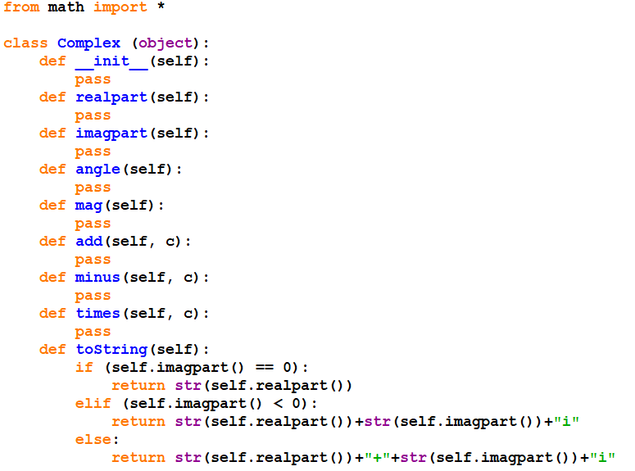
Python (interface)

Slide 53
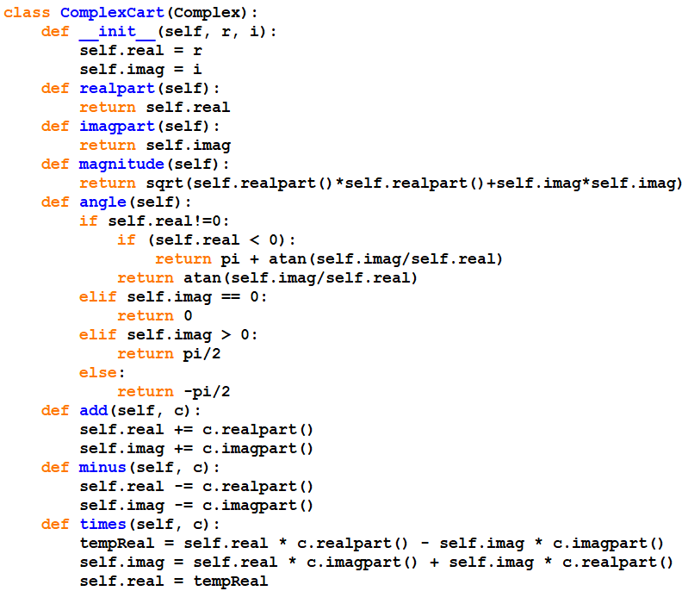
Python (ComplexCart)

Slide 54
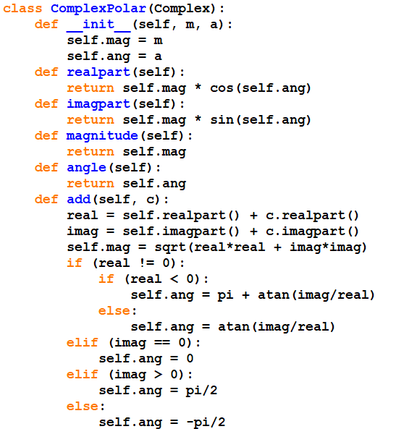
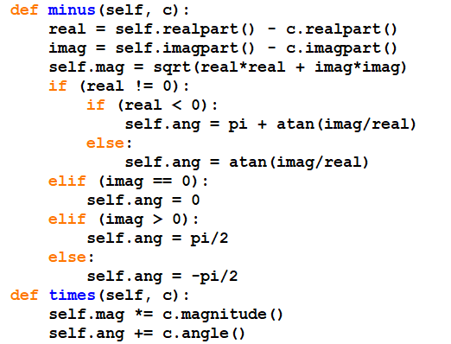
Python (ComplexPolar)

Slide 55
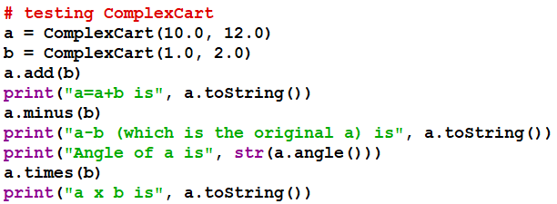
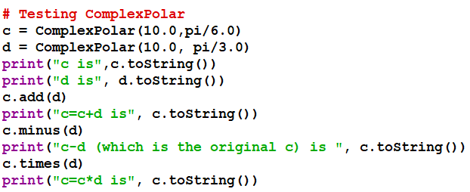
Python (Testing)

Slide 56
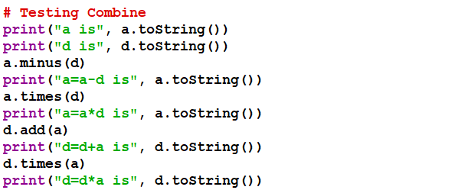
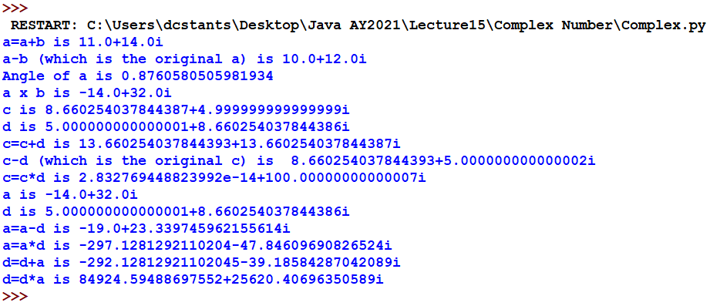
Python (Testing combined)

Slide 57
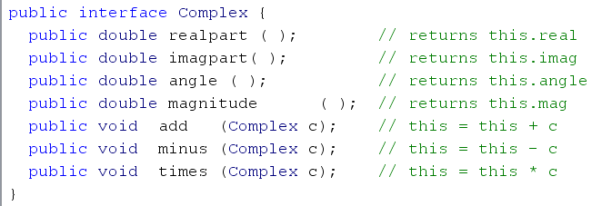
Java (Interface)

Slide 58
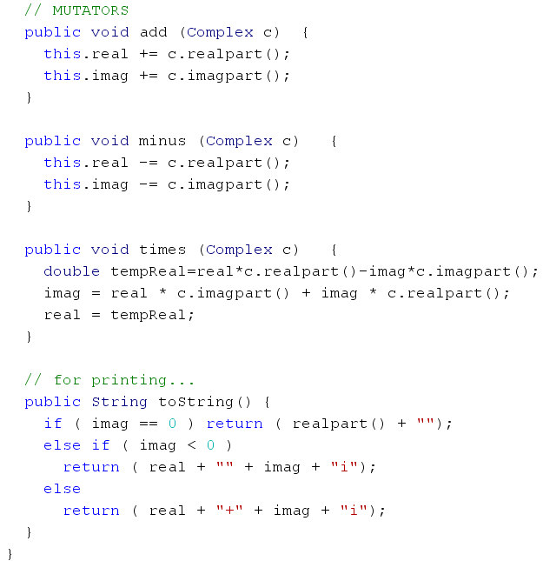
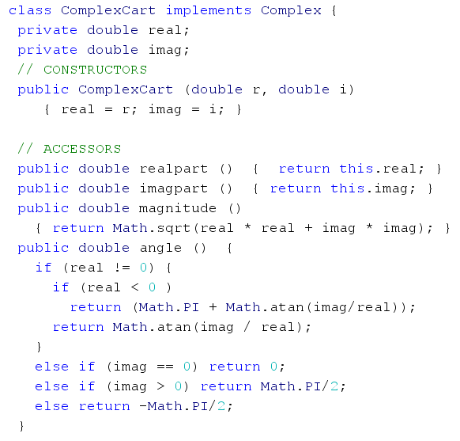
Java (ComplexCart)

Slide 59
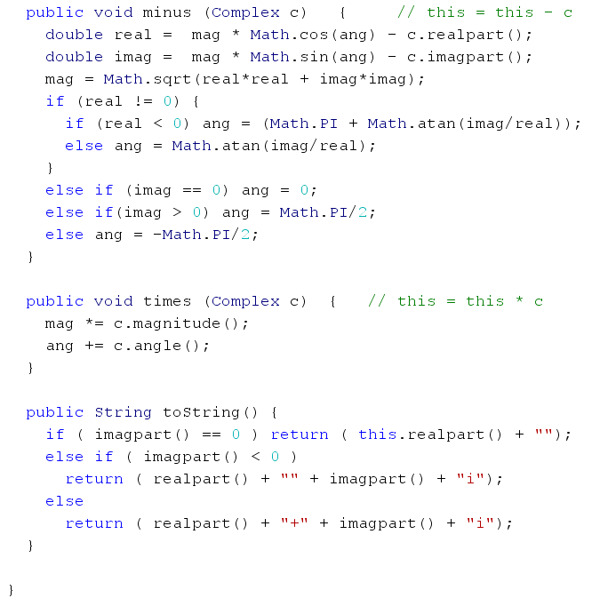
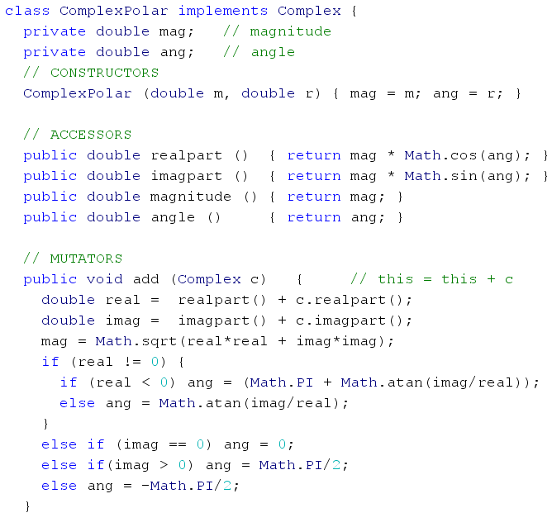
Java (ComplexPolar)

Slide 60
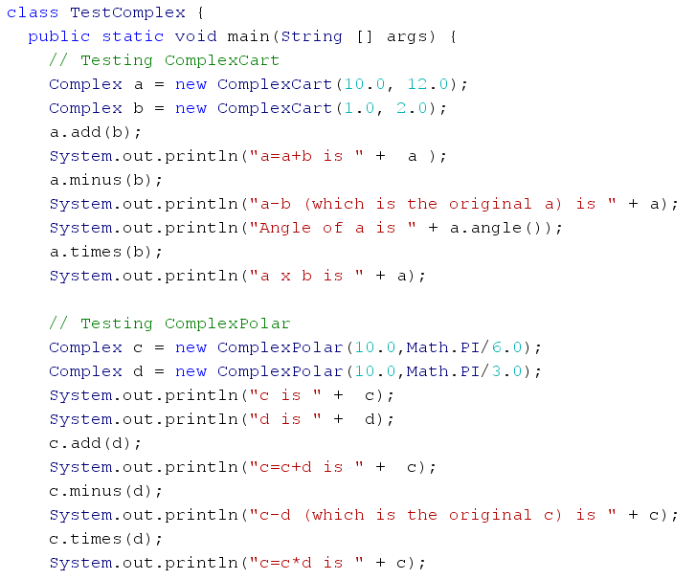
Java (Testing)

Slide 61
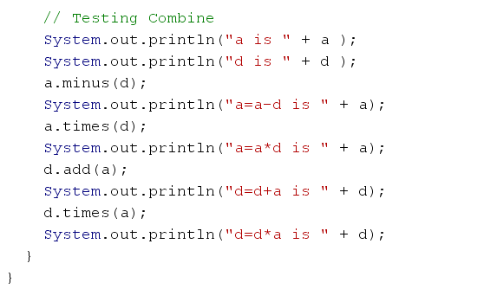
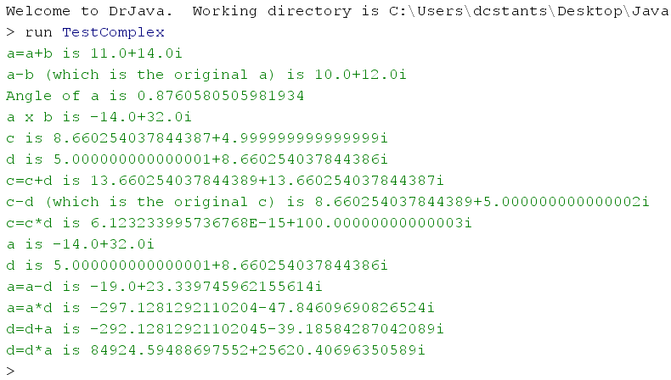
Java (Testing Combined)

Slide 62
Summary
Object Oriented Features:
- Encapsulation
class and object
attribute and method
- Inheritance
superclass and subclass
method over-riding
subclass substitutability
- Polymorphism
Static – compile-time
Dynamic – run-time

